Slide 1
F
I
R
S
T
C
O
R
N
A
N
I
T
H
I
S
9.19-10.10
A free CD of this message will be available following the service
It will also be available for podcast later this week at calvaryokc.com

Slide 2
Temperate - NASB, self-control
NIV, strict training
O
A
N
S
9.19-10.10
I
I
F
I
R
S
T
C
R
N
T
H

Slide 3
C. S. Lewis – “If we consider the unblushing promises of reward and the staggering nature of the rewards promised in the Gospels, it would seem that our Lord finds our desires, not too strong, but too weak. We are half-hearted creatures, fooling about
O
A
N
S
9.19-10.10
I
I
F
I
R
S
T
C
R
N
T
H

Slide 4
with drink and sex and ambition when infinite joy is offered us – like an ignorant child who wants to go on making mud pies in a slum because he cannot imagine what is meant by the offer of a holiday at sea. We are far too easily pleased.”
O
A
N
S
9.19-10.10
I
I
F
I
R
S
T
C
R
N
T
H

Slide 5
Gal. 5:13 - For you, brethren, have been called to liberty; only do not use liberty as an opportunity for the flesh, but through love serve one another.
O
A
N
S
9.19-10.10
I
I
F
I
R
S
T
C
R
N
T
H

Slide 6
Disqualified - adokimos – to fail the test
literally, disapproved
O
A
N
S
9.19-10.10
I
I
F
I
R
S
T
C
R
N
T
H

Slide 7
Canaan
< 2 weeks
Kadesh Barnea
40 years
Sinai?
1 month
Sinai?
O
A
N
S
9.19-10.10
I
I
F
I
R
S
T
C
R
N
T
H

Slide 8
Num. 11:4 - Now the mixed multitude who were among them yielded to intense craving; so the children of Israel also wept again and said: “Who will give us meat to eat?”
O
A
N
S
9.19-10.10
I
I
F
I
R
S
T
C
R
N
T
H

Slide 9
Ps. 116:13-15 - ¹³ They soon forgot His works;
They did not wait for His counsel,
¹⁴ But lusted exceedingly in the wilderness,
And tested God in the desert.
¹⁵ And He gave them their request,
But sent leanness into their soul.
O
A
N
S
9.19-10.10
I
I
F
I
R
S
T
C
R
N
T
H

Slide 10
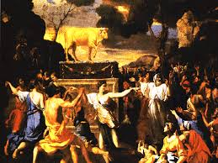
Ex. 32 - 3,000 died
O
A
N
S
9.19-10.10
I
I
F
I
R
S
T
C
R
N
T
H

Slide 11
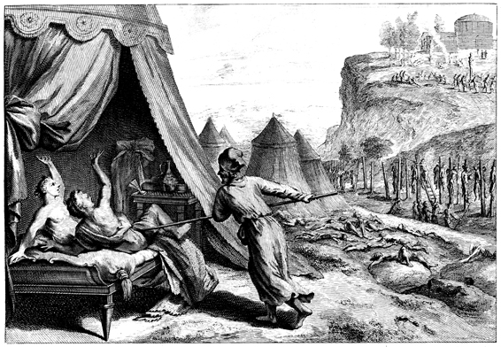
Num. 25 – Balaam (false prophet)
Balak (Moabite King)
Phinehas (grandson of Aaron)
O
A
N
S
9.19-10.10
I
I
F
I
R
S
T
C
R
N
T
H

Slide 12
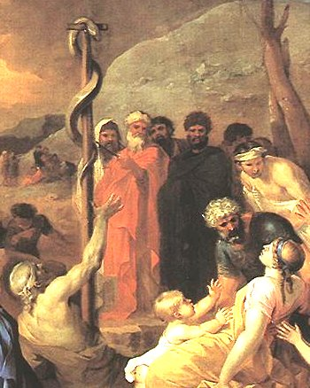
Numbers 21
Complain - gonguzō
KJV, muRmur
O
A
N
S
9.19-10.10
I
I
F
I
R
S
T
C
R
N
T
H

